Slide 1

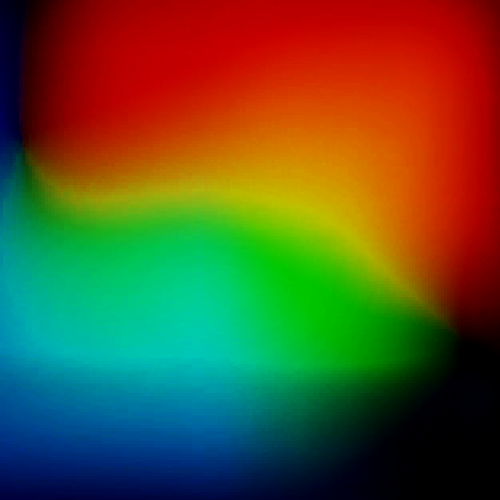
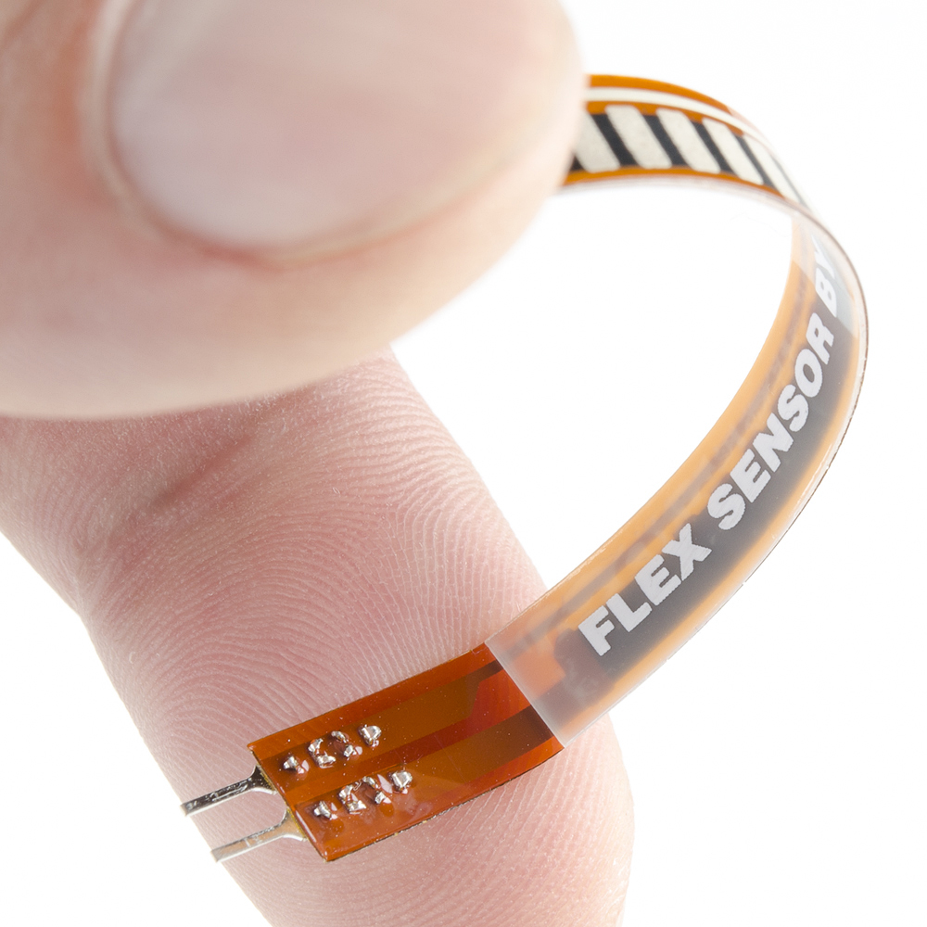
DEVELOPMENT OF
PVDF NANOCOMPOSITE BASED FLEXIBLE STRAIN SENSORS
SRAVAN S SANKAR
2019UMT0168
INSTRUCTOR: RANI ROHINI

Slide 2
CONTENTS
1
Genesis of Work
4
Experiment
2
Mxene and its properties
5
Characterizations
3
Steps for the synthesis of Mxene PVDF film
6
Future Work

Slide 3




GENESIS OF WORK
3
WHY FLEXIBLE SENSORS?
HOW SENSOR WORKS
WHY PVDF?
Having flexibility and sensitivity, it converts mechanical deformation or strain into an electrical signal, which can be detected and processed to obtain useful information.
Piezoelectricity
High Sensitivity
High Chemical Stability
Biocompatibility
Flexibility and Durability .
Ability to conform to irregular surfaces
Highly durable and resistant to damage from external forces

Slide 4
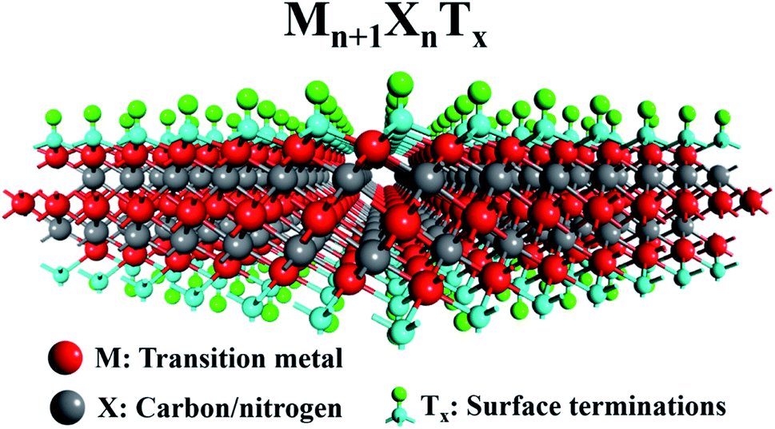
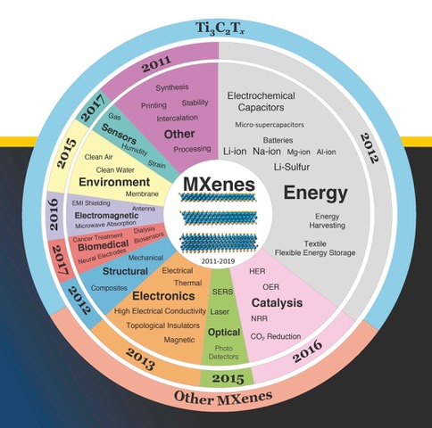
MXene-Filler in PVDF Matrix
Family of transition metal carbides , carbonitrides and nitrides.
MXenes are produced from layered ceramic precursors, typically M_{n+1}AX_{n}
The Physical & Chemical properties is modified by changing the composition and configuration of surface terminations
What are MXenes?
Unlike graphene and other 2D materials, MXenes are preferred because:
Easy to synthesize in bulk
Excellent electronic properties like high metallic conductivities(∼6000−8000 S/cm)
superior oxidation resistance and bending strength
High hydrophilic surfaces
High surface area
Advantages of MXene

Slide 5
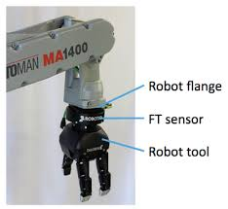
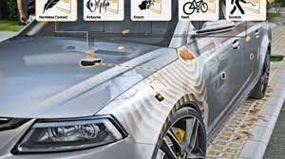


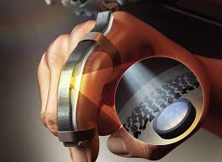

Robotics
Automotive
Sports
Detect changes in
forces and pressure
Allowing to adjust
Grip and touch
Improve safety
features that are
triggered by changes
in pressure
Aerospace
In Sports Equipments
to monitor impact
forces and prevent
injuries
In aircrafts, to
detect and monitor
Structural
changes over time
PROMISING
APPLICATION FIELDS
Healthcare
Industrial
Wearable health
Monitoring devices
like smart watches,
fitness trackers
To monitor
performance and
malfunction of
machineries

Slide 6





MATERIALS USED
6
01
02
03
04
Single Walled Carbon nanotubes Powder
N,N-Dimethyl formamide
MXENE
PVDF
MolWt:534000 g/mol
Sigma Aldrich
Mol.Wt.=73.09g/mol
Merk Life Science
Private Limited
Diameter:0.8 to 1.2 nm
NoPo Nanotechnologies India Private Limited.
Aritech Chemazone Private Limited.

Slide 7
COMPOSITIONS OF FILM PREPARED
7
Sample Code | MXene | PVDF | Total Reaction Time to get PVDF Nano composite mixture | Drying Oven Parameters | Compression molding parameters | Thickness of film (in Avg.)
MP1 | 1 wt.% (0.05 g) | 5g | 6 hours | 150 °C for 90 min | 200 °C, 50bar for 1 hr. | 471 μm
MP2 | 2 wt.% (0.10 g) | 5g | 6 hours | 150 °C for 90 min | 200 °C ,50 bar for 1 hr. | 248 μm
MP3 | 3 wt.% (0.1546g) | 5g | 6 hours | 150 °C for 90 min | 200 °C ,50 bar for 1 hr. | 287 μm
MP4 | 4 wt.% (0.2083g) | 5g | 6 hours | 150 °C for 90 min | 200 °C ,50 bar for 1 hr. | 267 μm
MP5 | 5 wt.% (0.2631g) | 5g | 6 hours | 150 °C for 90 min | 200 °C,50 bar for 1 hr. | 269 μm

Slide 8
COMPOSITIONS OF FILM PREPARED WITH SWCNT
8
Sample Code | MXene | PVDF | CNT | Total Time to get PVDF Nano composite mixture | Drying Oven Parameters | Compression molding parameters | Thickness of film (in Avg.)
CP1 | NA | 3g | 1Wt.% (0.030g) | 6 hours | 150 °C. for 90 min | 200 °C,50 bar for 1 hr. | 190 μm
PC1M3 | 3 Wt.% (0.09 g) | 2.88g | 1 Wt.% (0.03 g) | 6 hours | 150 °C for 90 min | 200 °C ,50 bar for 1 hr. | 205 μm
PVDF | NA | 5g | NA | NA | 150 °C for 90 min | 200 °C,50 bar for 1 hr. | 171 μm

Slide 9
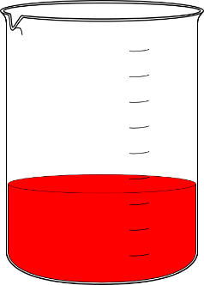
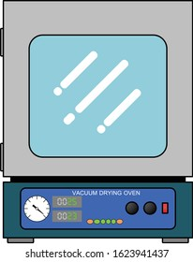


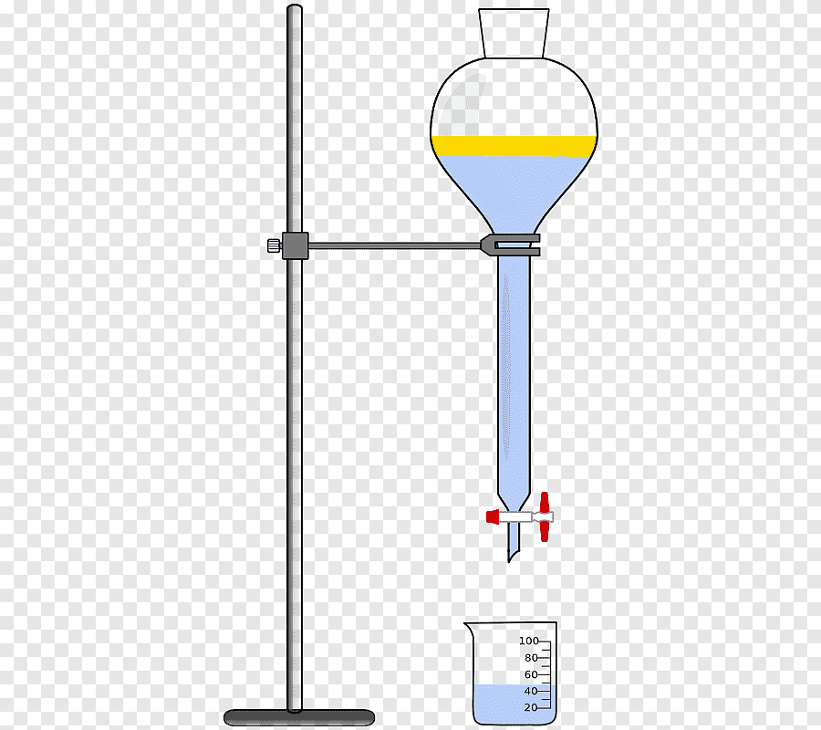
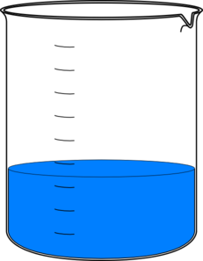
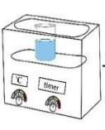
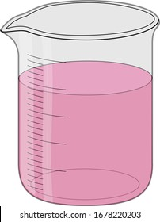
SCHEMATIC FOR THE SYNTHESIS OF MXENE-PVDF COMPOSITE FILM
SOLN A
MXene(say x wt.%) is dispersed in 30ml DMF by Ultrasonication by heating at 50 DegC for 1 hr.
SOLN C
SOLN B
Mix both Soln. A and Soln.B
Magnetic stirring for 2 hr. at 100ºC
Ultra sonication at 50ºC for 30 min
Precipitation of MXene–PVDF mixture using DI water
Drying in oven at 150ºC for 90 min
Making Composite film in compression molding machine
PVDF (5g) is dissolved in 60 ml DMF by magnetic stirrer for 45 min

Slide 10
SCHEMATIC FOR THE SYNTHESIS OF CNT- PVDF COMPOSITE FILM
SOLN A
CNT is dispersed in 30ml DMF initially by Probe sonication and then by UltrI sonication by heating at 50 DegC for 1 hr.
SOLN C
SOLN B
Mix both Soln. A and Soln.B
Magnetic stirring for 2 hr. at 100degC
Ultra sonication at 50 degC for 30 min
Precipitation of Mxene –PVDF mixture using DI water
Drying in oven at 150 DegC for 90 min
Making Composite film in compression mouding machine
PVDF(5g) is dissolved in 60 ml DMF by magnetic stirrer for 45 min

Slide 11
SCHEMATIC FOR THE SYNTHESIS OF MXENE-CNT- PVDF COMPOSITE FILM
SOLN A
Dispersed MXene
SOLN B
SOLN D
Dispersed CNT
Mix both Soln. A and Soln.B
Magnetic stirring for 2 hr. at 100degC
Ultra sonication at 50 degC for 30 min
Precipitation of Mxene –PVDF mixture using DI water
Drying in oven at 150 DegC for 90 min
Making Composite film in compression molding machine
SOLN C
Dissolved PVDF

Slide 12
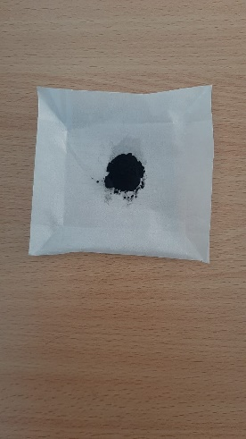
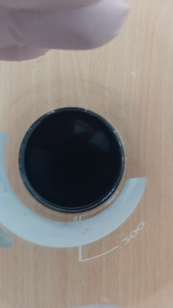
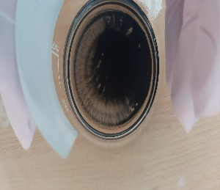
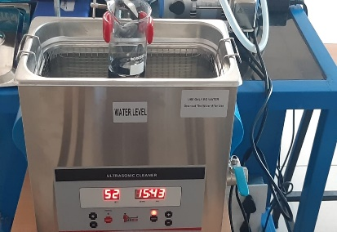
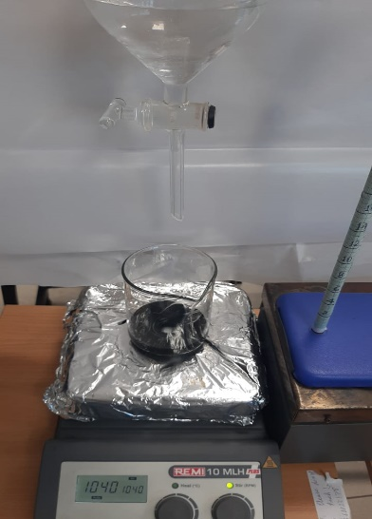
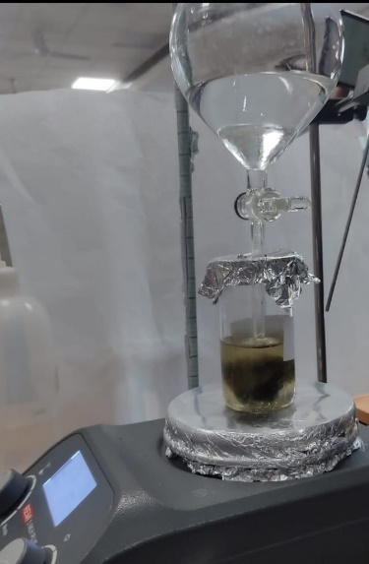
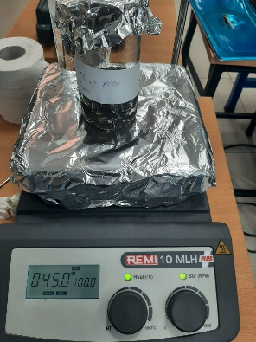
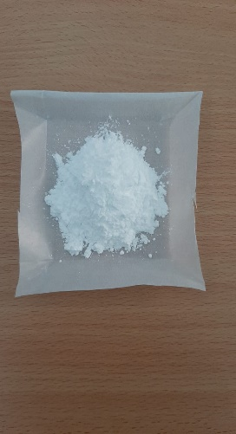
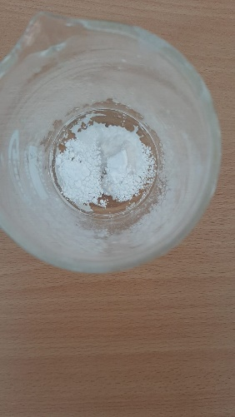
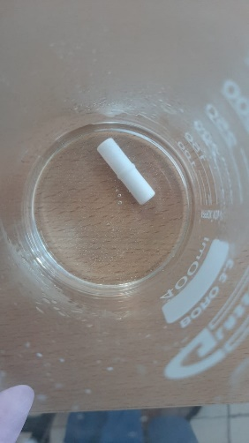
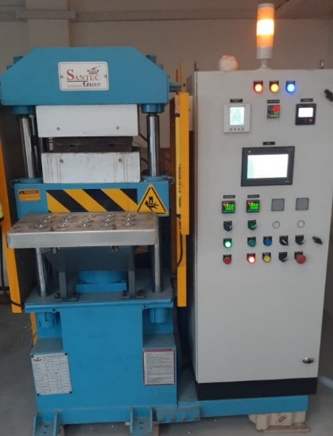
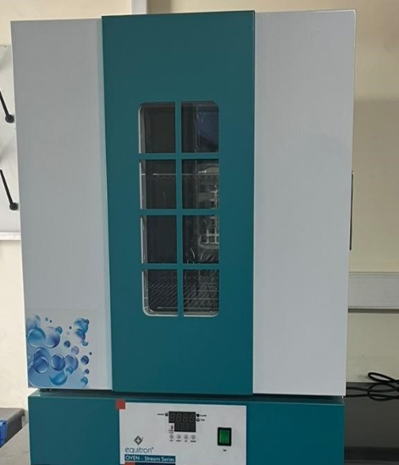
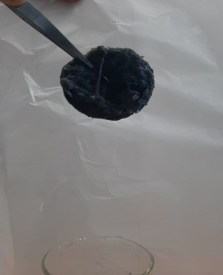
EXPERIMENT
12
Dispersing MXene
Adding DI Water
Dissolving PVDF
Compression Molding
Precipitated Product.

Slide 13
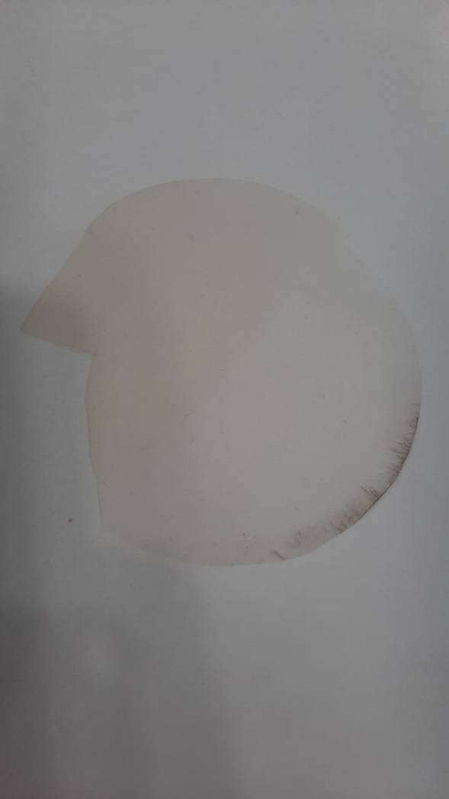
PVDF FILM
AVG.THICKNESS:171 μm

Slide 14
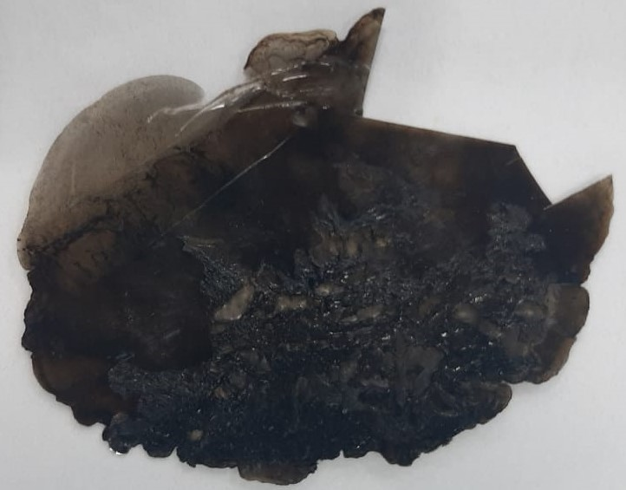
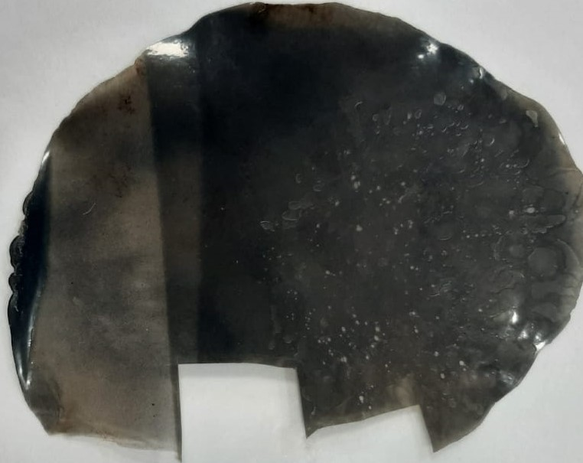
DIFFERENT COMPOSITIONS OF MXENE-PVDF FILM
MXENE(1 Wt.%)-PVDF FILM
AVG. THICKNESS : 471 μm
MXENE(2 Wt.%)-PVDF FILM
AVG. THICKNESS : 248 μm

Slide 15
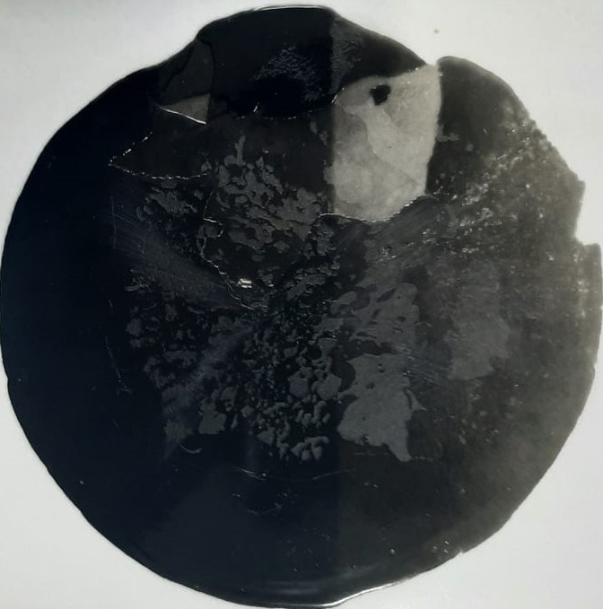
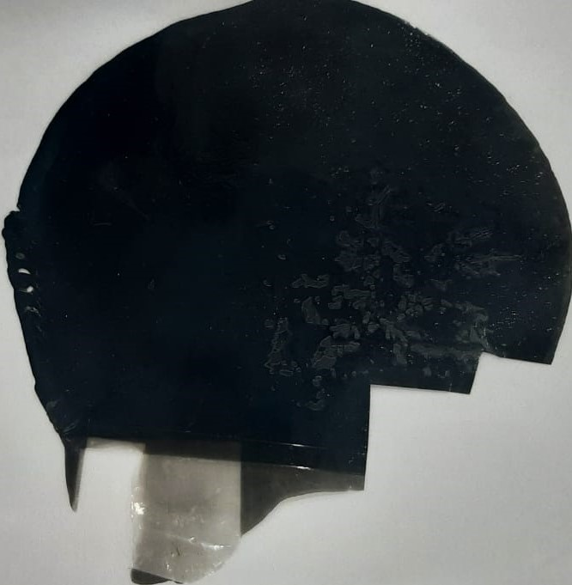
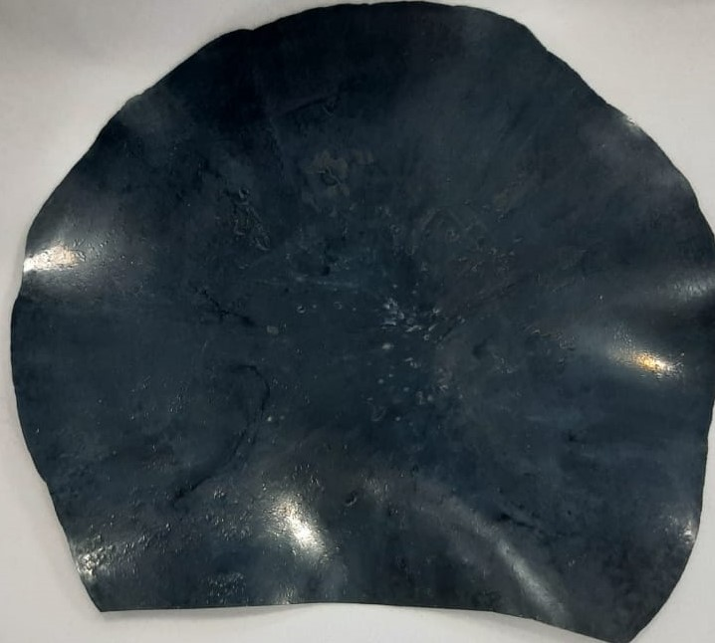
MXENE(3 Wt.%)-PVDF FILM
AVG. THICKNESS : 287 μm
MXENE(5 Wt.%)-PVDF FILM
AVG. THICKNESS : 269 μm
MXENE(4 Wt.%)-PVDF FILM
AVG. THICKNESS : 267 μm

Slide 16
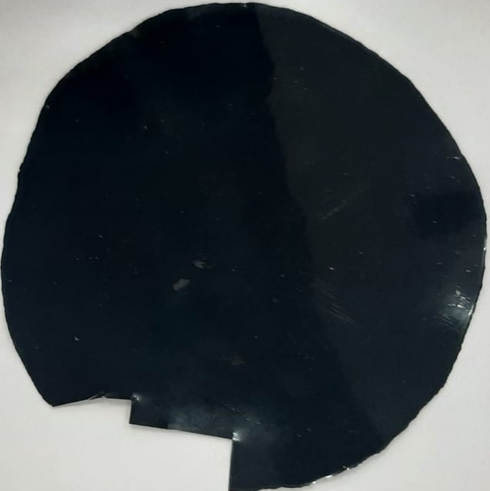
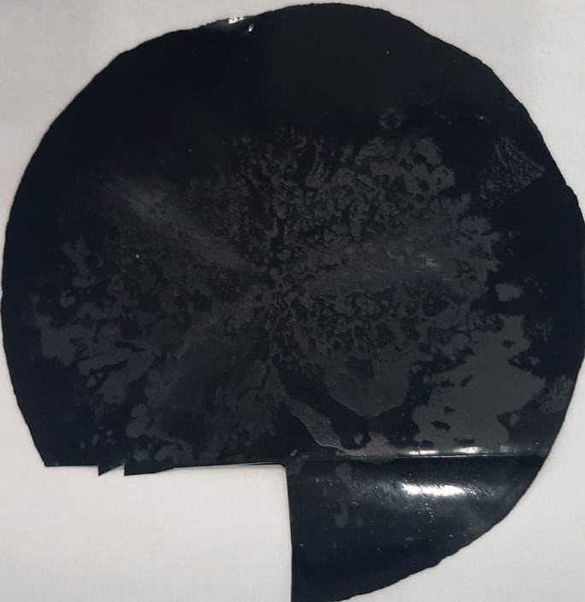
CNT (1 Wt.%)-PVDF FILM
AVG. THICKNESS : 190 μm
CNT (1 Wt.%)-MXENE (3 Wt.%)-PVDF FILM
AVG. THICKNESS : 205 μm

Slide 17
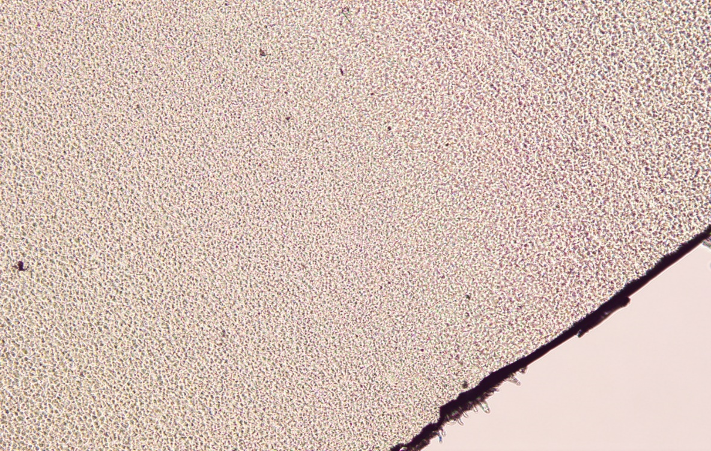
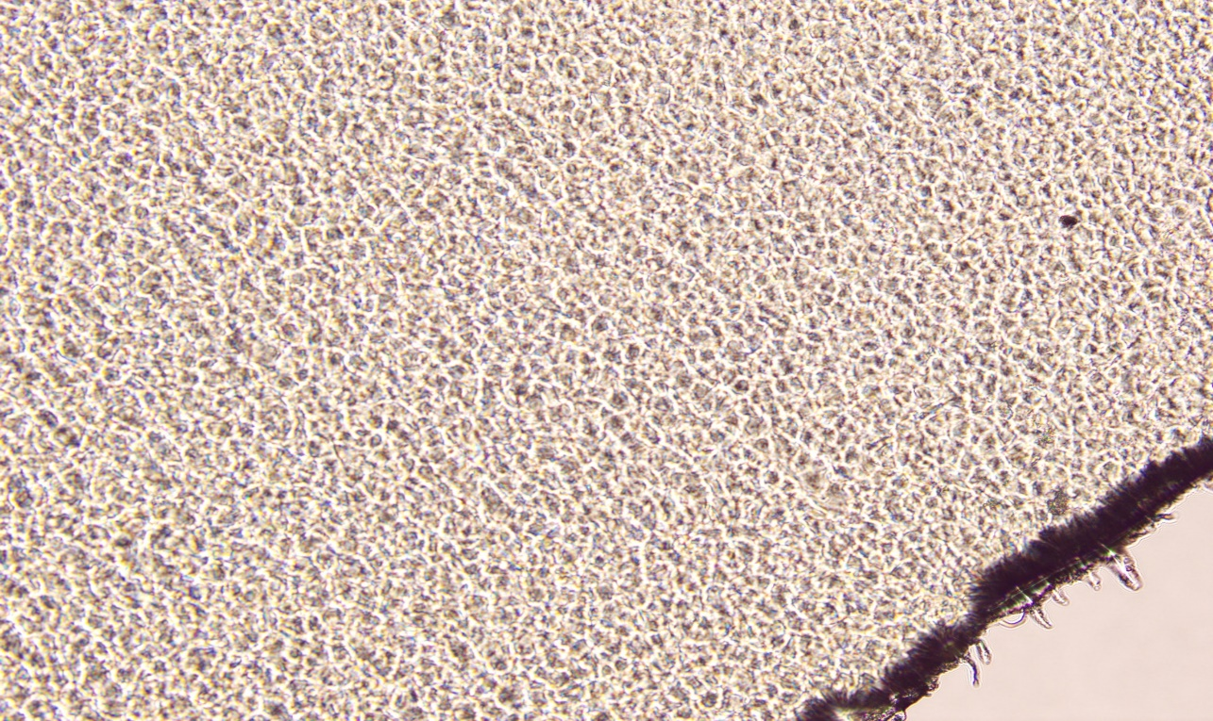
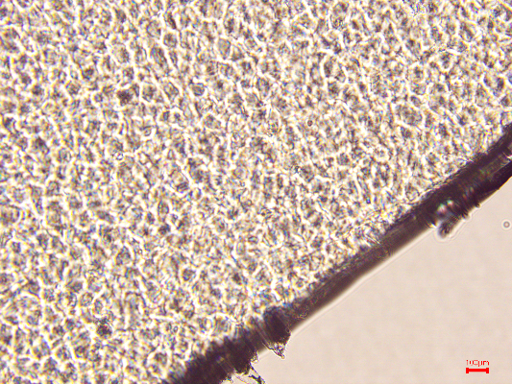
OPTICAL MICROSCOPE IMAGE OF PVDF
PVDF 5X
PVDF 10X
KEY POINTS TO OBSERVE:
Crystalline region
Concept of birefringence
PVDF 20X

Slide 18
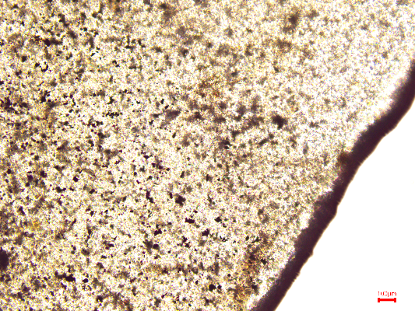
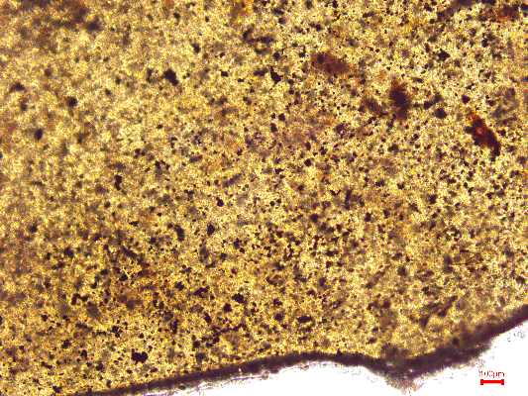
OPICAL MICROSCOPE IMAGE OF MXENE-PVDF FILM
1 wt.% 10X
2 wt.% 10X

Slide 19
OPTICAL MICROSCOPE IMAGE OF MXENE(4%)-PVDF FILM
19
5X
5X
The presence of distinct regions with different colors or textures in the image could indicate phase separation between MXene and PVDF.
The white lines could also be indicative of scratches (or) it is also possible that the white lines are due to imaging artifacts, such as glare or reflection from the surface of the material, or variations in focus during the imaging process used to acquire the image

Slide 20
SEM ANALYSIS- MAX PHASE
(MAX) Large crystals showing the compact layered structure and highly smooth surface

Slide 21

SEM ANALYSIS-MXENE
“Accordion” like morphology: Stacked thin flat MXene sheets as shown above
Distinct layers more clearly visible with HF conc. which ultimately produces gaseous hydrogen.
Surface looks rough with pores and irregularities
SEM reveals oxide nanoparticles(Titanium oxide particles) on the outsides of the layers, which are indicative of the severe etching process and oxidation on the surface as in fig©

Slide 22
SEM ANALYSIS OF MXENE-CNT-PVDF
MXENE
CNT

Slide 23
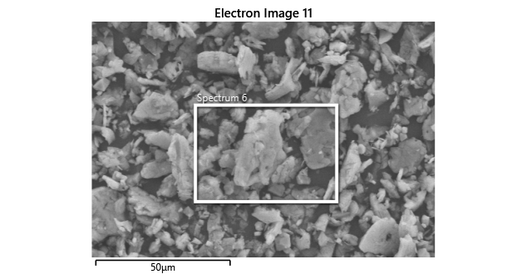
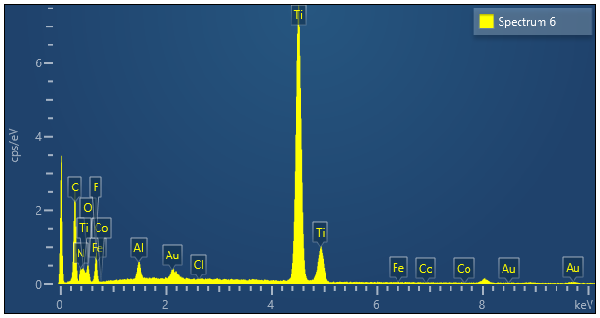
Energy-dispersive X-ray spectroscopy (EDS)
Qualitative elemental analysis and elemental mapping of elements.

Slide 24
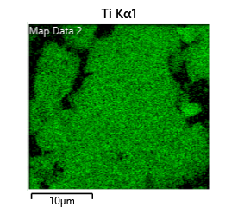
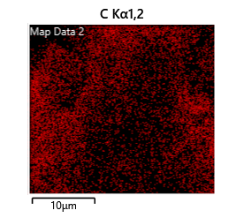
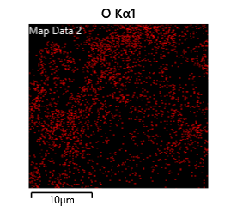
EDS GRAPH DATA AND MAPPING
Element | Wt.%
C | 26.27
O | 11
F | 15.31
Ti | 45.02

Slide 25
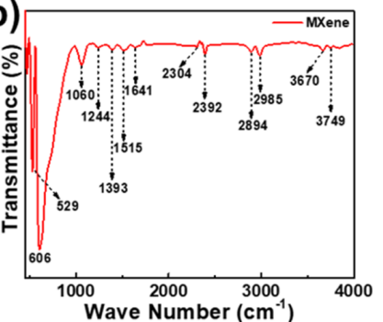
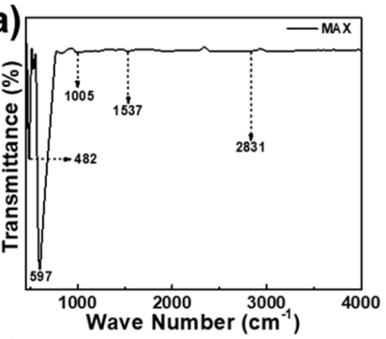
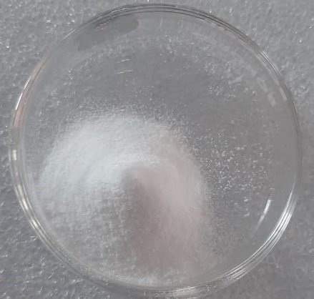
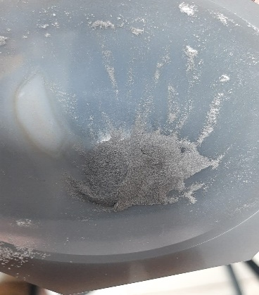
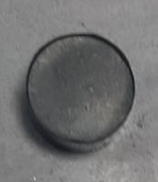
FTIR SPECTRUM OF MAX AND MXENE
FOR REF.
FOR REF.

Slide 26
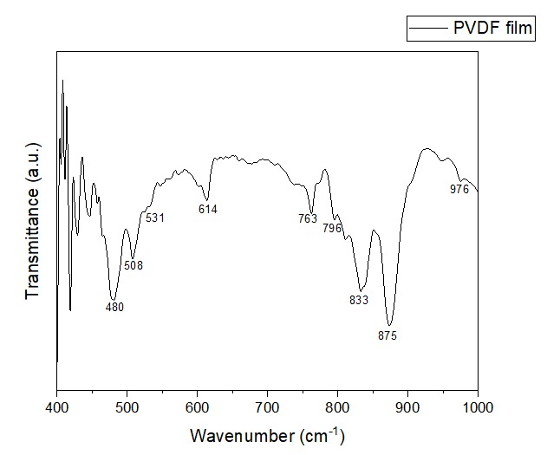
FTIR SPECTRUM OF PVDF FILM
The absorption bands at 480, 531, 614, 763, 797, 875, and 976 cm⁻¹, are the characteristic of α-phase
The absorption bands at 508 and 833 cm⁻¹ are characteristic of β-phase
Indicates stretching and bending vibration of C-H₂, C-F₂ bonds

Slide 27
FTIR PLOT
27
For PVDF Powder:
762.7(α) cm⁻¹ : CF₂ bending and skeletal bending mode.
795(α)and 974.8(α) cm⁻¹ : CH₂twisting mode.
838(γ)cm⁻¹ : CH₂ rocking mode,
871.66(α)and 1069(α) cm⁻¹ :CC skeletal stretching vibration
1171(β)cm⁻¹ :CF₂ out-of-plane deformation
1400.067(α) cm-1 :CF₂ wagging mode
NOTE: In the FTIR spectra of the PVDF/Ti₃C₂T_{x} Nano composites with different filler loadings i.e. in MP1,MP2……MP5) intense peaks of α- and β-phases are observed. Therefore, it can be noted that the introduction of the Ti₃C₂T_{x} MXene filler into the PVDF matrix does not change the phase composition of PVDF
Normally 838 band is common to the β and γ-phases; But as seen from plot a broad band with low intensity indicates the γ-phase. This broad band is due to superimposition with the 833 cm⁻¹ band.
What expected: From the FTIR results of the PVDF films, we expected disappearance the peaks that appear in the α-phase namely, 762.7, 795 and 974.8 in the PVDF films. By this, it indicates to transfer the phase of the PVDF from α to the β-phase. But from graph we can see that peaks still there so small potion of β or no β Phase formed

Slide 28


UV-VIS-NIR SPECTROSCOPY
For MAX phase: The spectrum is typically flat and electronic transitions are typically in the deep ultraviolet or X-ray range, which is outside the range of the UV-Vis-NIR spectrum.
MXenes exhibit strong absorption in the ultraviolet region due to the presence of transition metal carbide or nitride layers. The absorption in the visible and near-infrared regions is weak, but it can be enhanced by modifying the surface chemistry or by introducing surface Plasmon resonances.
Its unique feature is a plasmonic peak around 780 nm, which gives MXene its color

Slide 29
XRD PLOT
The strong peak at 39.6°of Ti₃AlC₂ vanishes, indicating that the Al layer is completely eliminated.
In addition, the representative peak (13°) moves to a lower angle (8.9°), suggesting that the layer spacing of MXene increases after etching

Slide 30

XRD PLOT
30
XRD pattern of pure PVDF film and PVDF/MXene showed some peaks which indicates that it possess α-crystallite as in fig.
As per literature, the β phase is presents a peak value of 20.26°.
Here with addition of fillers (MXene) into polymer (PVDF) we expect the peak at 19.8° to shift to higher degree i.e. the peak of β phase at 20.26°.Also the Characteristic peaks of α-phase, located at 17.6° and 18.2, tended to get weaker and the one at 26.5 to get vanished.

Slide 31

XRD PLOT
31
The α-peak area is reducing upon loading the MWCNT to the matrix to promote the crystallization of PVDF in the β -phase.
But this crystallization of β-phase not fully occurring because of TGTG′ chains not transforming into TT chains and weak interfacial interaction between CNTs and the polymer matrix.
Note: It is important to note that the absence of the beta phase does not necessarily mean that the material is not conducting. There are other factors that could contribute to the electrical conductivity of the composite, such as the CNT content loading level, alignment, and length distribution, as well as the processing conditions used to fabricate the composite.

Slide 32
CONCLUSIONS FROM XRD AND FTIR PLOT
32
We can see that α(non- polar) phase to β(polar) conversion is not fully happening which is against what we expected to happen. Normally, the surface functional groups of MXene interact with the CH₂ group of PVDF, leading to enhanced β-phase formation with increase in weight percent of Mxene in Mxene-PVDF film.
PVDF exhibits excellent dielectric and piezoelectric performances owing to the electro active β-phase which in turn responsible for electrical conductivity.

Slide 33



ELECTRICAL CONDUCTIVITY MEASUREMNT :FOUR PROBE METHOD
Measure voltage by varying current .
𝜌_{𝑜} = ( 𝑉 /𝐼 ) ∗ 2𝜋S
(S=spacing between point probes,0.2 cm
V = floating potential difference between the inner probes,
𝐼 =current through the outer pair of probes)
Since thickness W<< s;
Correction factor G7=W/s
Final Resistivity 𝜌= 𝜌_{𝑜} /G7
Conductivity σ = 1/𝜌
Conductivity of CNT(1 Wt.%)-PVDF Film=60337.83 S/cm
Conductivity of MXene(3 Wt.%)-CNT(1 Wt.%)-PVDF Film=48894.26 S/cm

Slide 34
FUTURE WORK
Performing conductivity test of all films.
Understanding changes in properties (thermal, electrical, electromechanical etc)
Fabrication of sensors.

Slide 35
T
H
A
N
K
Y
O
U

